Slide 1
Functions II

Slide 2
Outline
Documentation
Docstrings
Loops/iteration
For loops
While loops
List comprehension
Exceptions/errors

Slide 3
Documentation
Comments
Docstrings
explain how specific parts work
written for maintainers
Can appear anywhere within function body
Ignored at runtime
Use sparingly to clarify code
explains what the function does
written for users of the function
first statement inside the function definition
Accessible via help
Use to describe interface and intent

Slide 4
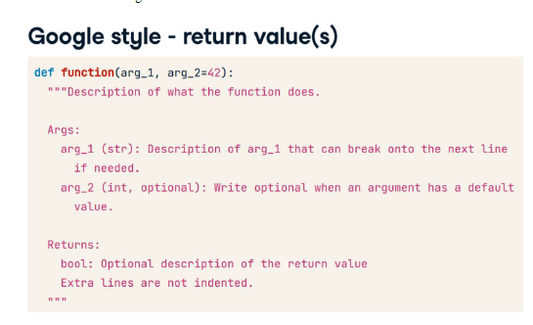

Slide 5
For loops
Known repetition
Number of iterations known in advance
for object in iterable: do something

Slide 6
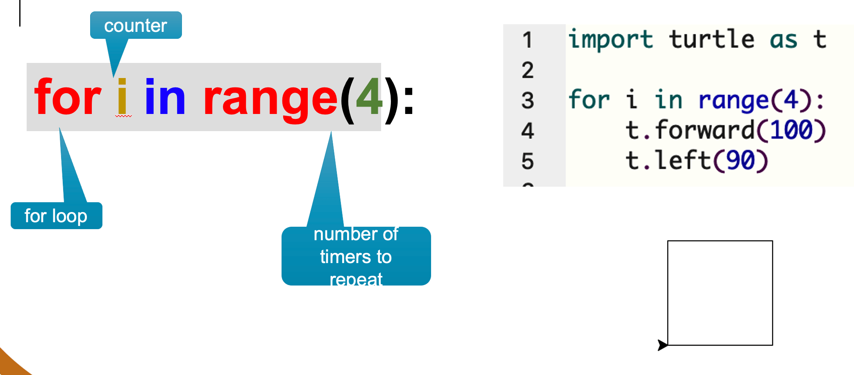

Slide 7
While loops
Conditional repetition
Number of iterations not known
Continue iterating until condition is met
Risk of infinite loop
While a value is less than a value do something

Slide 8
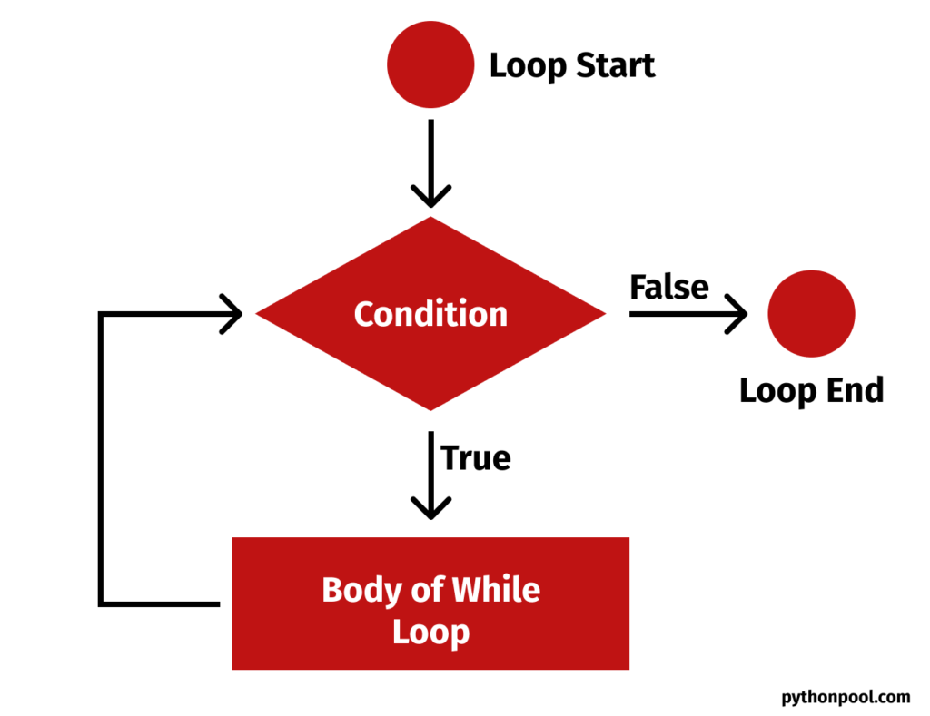

Slide 9
Infinite loops
Different causes:
Human error x = 0 while x<10: print(x)
Mechanical
Network loops
Threshold
Solution to mechanical: Maximum number of iterations

Slide 10
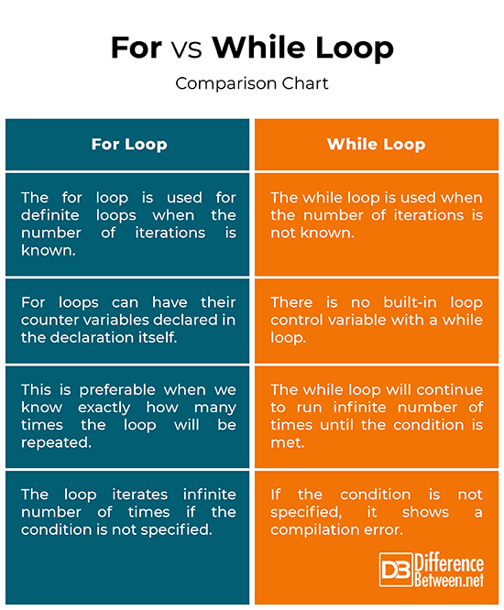

Slide 11
For or while loop?
Process every row in a spreadsheet
Keep asking for a password until the user enters the correct one
Calculate the total for each item in a shopping cart
Download a file in chunks until the download is complete
Send a welcome email to each new registrant
Continue a countdown until a specified value is reached

Slide 12
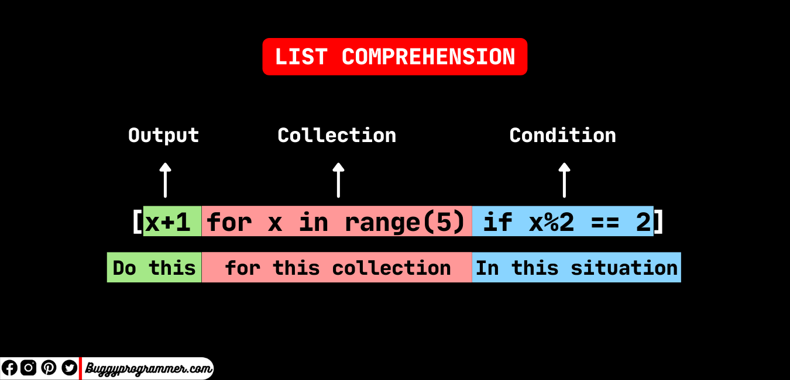
List comprehension
Single line loop over iterable object to produce a new collection
3 parts:
Output
Iterable
Condition

Slide 13
List comprehension: Nested loops
Multiple for loops: Logic flows from same way
Explicit
matrix = []
for row in range(3): # outer loop → rows
row_list = []
for col in range(4): # inner loop → columns
row_list.append(row * col)
matrix.append(row_list)
print(matrix)
Outer loop, then inner loop, then inner loop
matrix = [[row * col for col in range(4)] for row in range(3)] print(matrix)

Slide 14
Errors
What if something goes wrong with code?
Figuring out error messages
Debugging
Exceptions
Notes:
- Last week we looked at making sure inputs were correct

Slide 15
Error messages
Syntax errors
Grammatical errors in code
Runtime errors
Logical errors
Code does not produce correct results

Slide 16
Runtime errors
NameError – Function or object does not exist
TypeError – Operation on incompatible data type
IndexError - Index value specified out of range
AttributeError – Attribute does not exist for object type

Slide 17
Debugging
Narrowing uncertainty about where something went wrong and why
Options:
Print commands
Breakpoints
Logging
Dedicated debuggers

Slide 18
Exceptions
Useful in functions
Anticipating potential errors and specifying what happens if they occur
Do this rather than let the program crash
try…except
try = Run this block of code
Except = if error in try block do this
def safe_convert(value):
try:
return float(value)
except (ValueError, TypeError):
return None

Slide 19
Exceptions, part 2
Use try/except sparingly
Wrap only code that may fail
Catch specific exceptions
Don’t use it for normal logic that can be checked
Log or handle the error meaningfully

